Slide 1
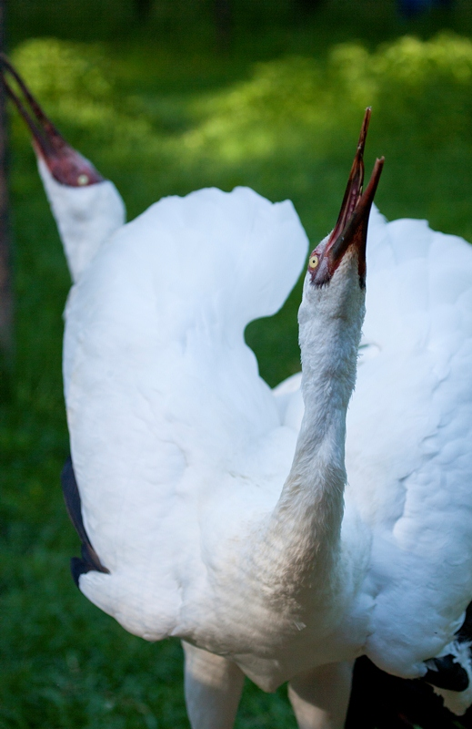
Conservation of Siberian crane
in Yakutia
Larisa Shelokhovskaya, Directorate of biological resources and protected areas
Inga Bysikatova, Institute of biology, SB RAS
Photo: A. Kamenev

Slide 2


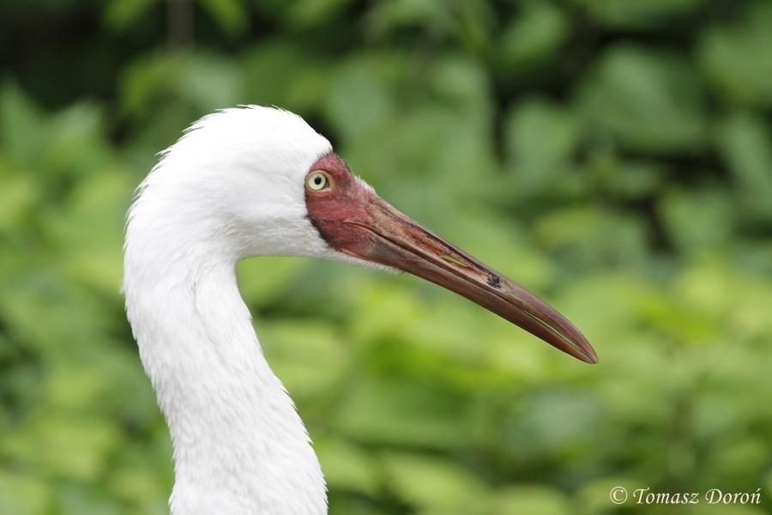
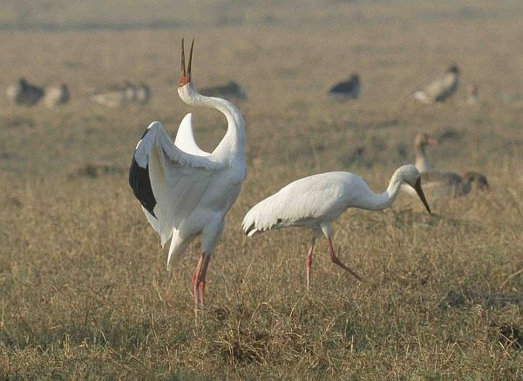
Sterkh or Siberian Crane (Leucogeranus leucogeranus)
Distribution: Eastern Siberia, Yakutia
Nesting: North-Eastern Yakutia
Habitat: subarctic tundra, near lakes
Population number: approx. 3.500-4.000
Status: IUCN Redlist – critically endangered, Red Data Book of Russia and Red Data Book of Russia of Yakutia
Main threats:
Habitat transformation
Unfavorable weather conditions
Predators (wolverine, bear, birds)
Pollution of lakes by lead fractions
Disturbance (recreation, mammoth tusks seekers)
Hunting (Accidental)
Competition with Sandhill Crane

Slide 3
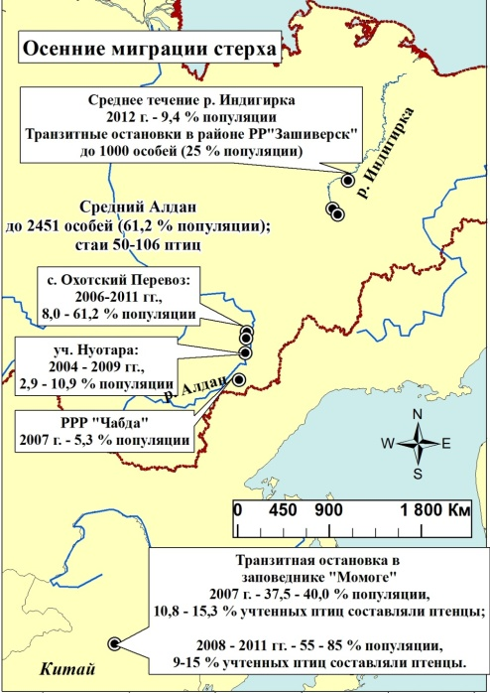
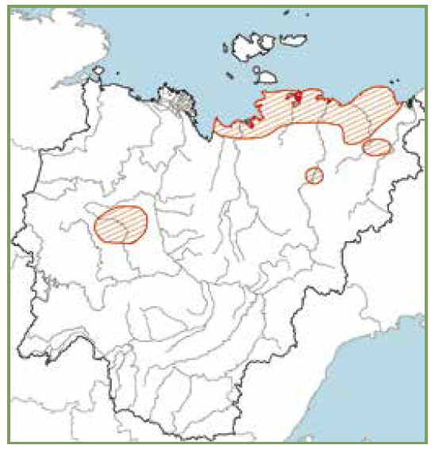
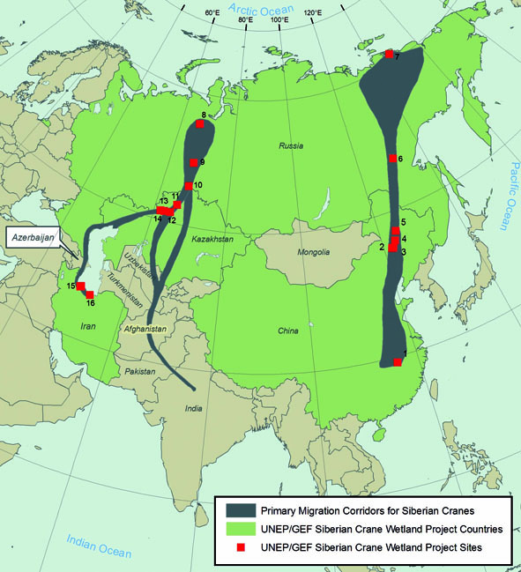
CONSERVATION ACTIONS NEEDED
Reach nesting sites in the middle of May
Nesting from late May to early June
Every pair needs about 11 sq.km., conservative
Half of the birds at nesting sites (pairs) are more than 20 years old
Feed on vegetation and fish
Autumn corridor of migration is very narrow
Distribution of Sterkh in Yakutia
Site/area protection
Habitat protection
Monitoring
RESEARCH NEEDED
Population size, distribution & trends
Distribution of Sterkh in the world
Notes:
Actions recognized on the international level

Slide 4

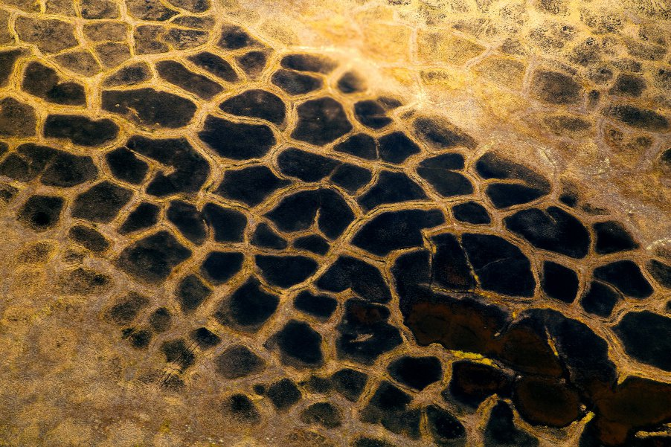
SITE PROTECTION
More than 20 protected areas were established on the migration route
within Yakutia in different locations from the North down to the South
On the breeding area the first protected area
Resource reserve “Kytalyk” was established in 1996 (IUCN VI)
In 2014 it became the State nature reserve “Kytalyk” (IUCN IV)
In 2019 Federal National park “Kytalyk” was established
KYTALYK NATIONAL PARK
The total area of the park is more than 1 mln. 885 thousand ha.
Aims to protect Siberian crane, habitats, waterfowls, wild reindeer, support traditional lifestyle, develop ecological tourism

Slide 5
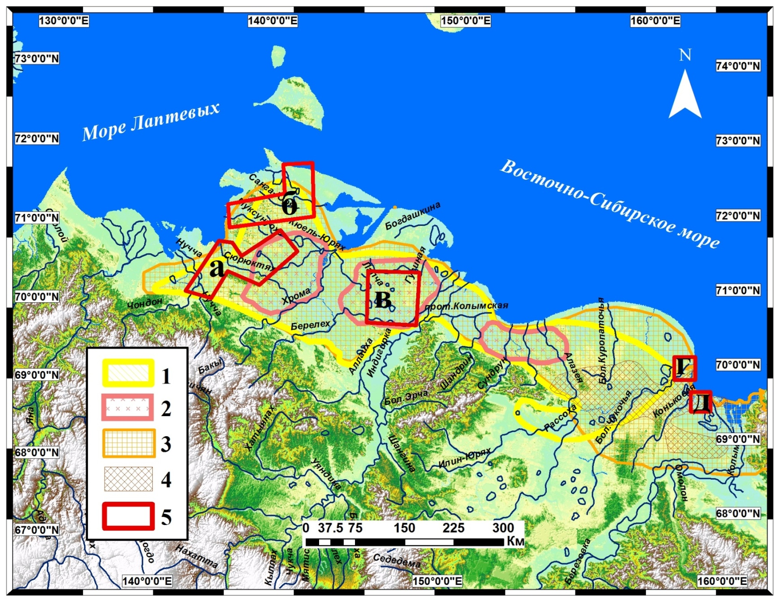
FIELD WORK SITE’S IN THE BREEDING AREA OF THE CRANES
IN NORTH-EASTERN PART OF YAKUTIA

Slide 6
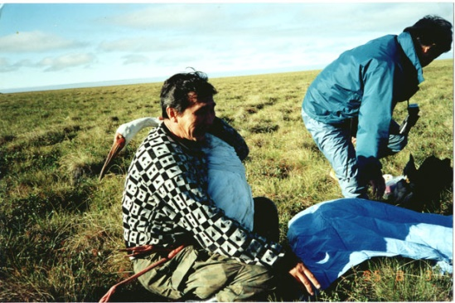
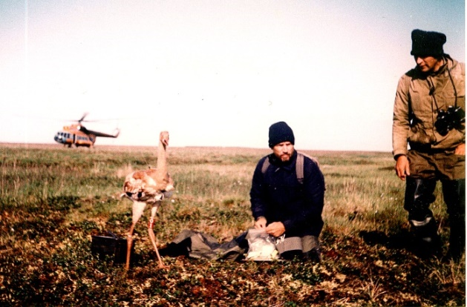
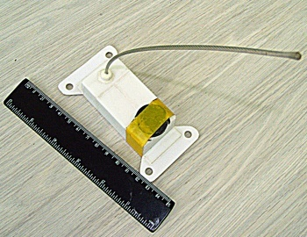
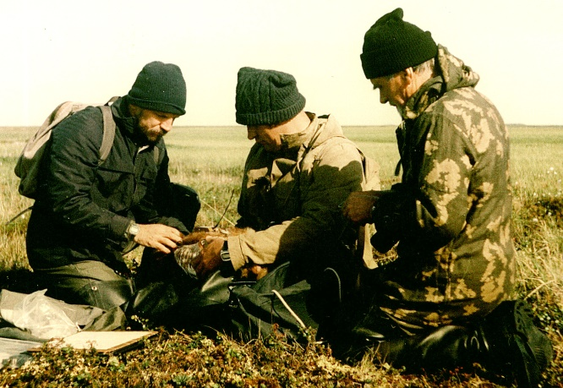
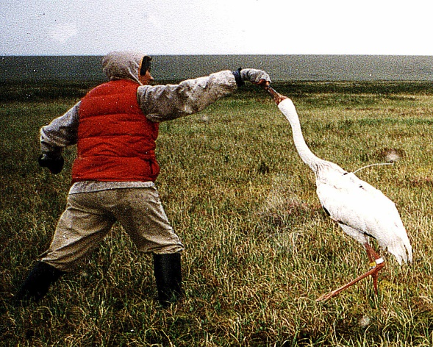
Regular monitoring studies began in the 90s of the last century. During this period, work began on banding of the Siberian Crane, first of all non-flying chicks (since 1990), and then adult molting birds (since 1993).
Almost simultaneously, work began on studying the movements of birds and establishing their migration corridor using satellite transmitters. For the first time, they were fixed on chicks (1992), later on adult birds (1993).
1992 г.
1995 г.
1992 г.
1996 г.

Slide 7
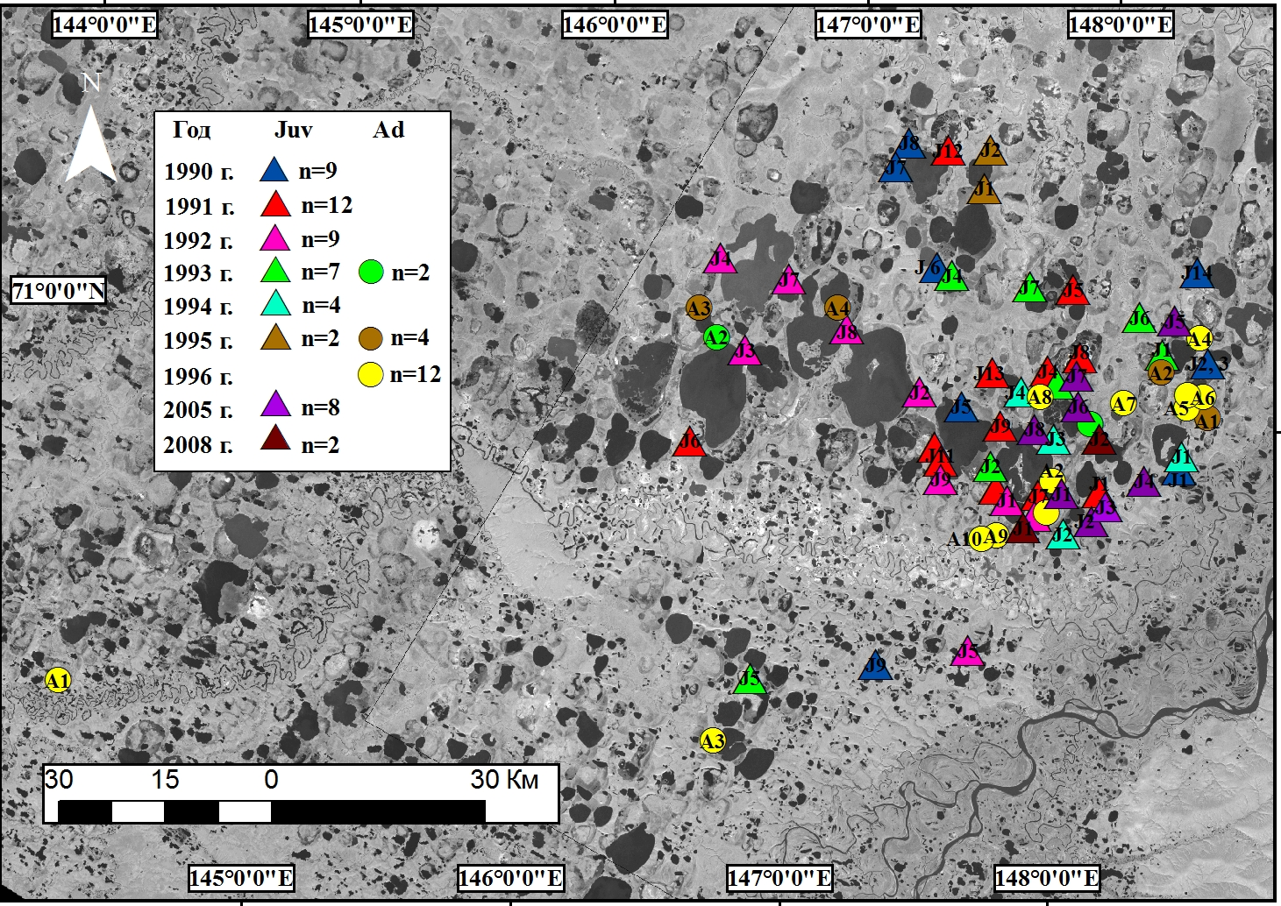
Sites of capture and banding of the Siberian Cranes in the main research area and in the adjacent areas in Indigirka tundra of 1990-2008. (n = 71, 18 adults (ad + sad) and 53 chicks ringed

